Slide 1

The Art of Image Creation in

Slide 2
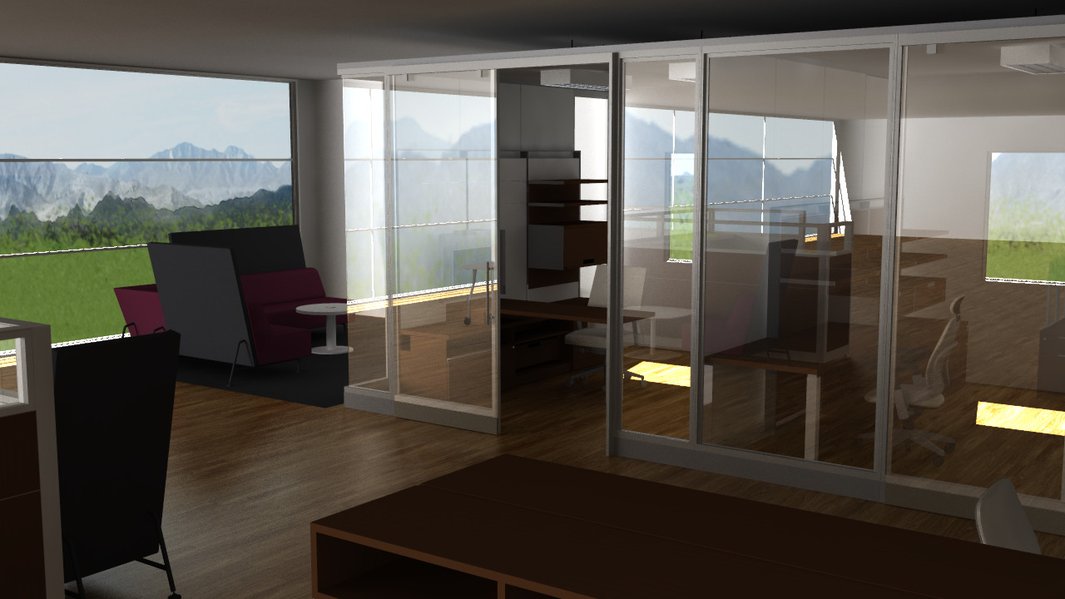

Slide 3


Slide 4
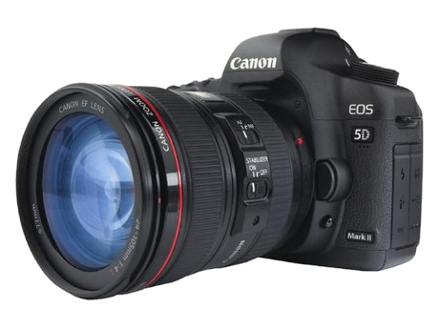
Who am I
Amateur photographer since 1998.
Digitally since 2000.
Interest peak 2005 – 2008.
Shoots with Canon EOS 5D Mark II + bunch of lenses. Mostly primes.
Master in Computer Science
R&D Developer @ Configura since 2005
In Grand Rapids, 3 years
Works currently in Gothenburg, Sweden
Amateur photographer since 1998.
Digitally since 2000.
Interest peak 2005 – 2008.
Shoots with Canon EOS 5D Mark II + bunch of lenses. Mostly primes.

Slide 5

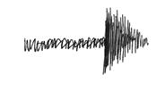
Disclaimer
No formal education in photography.
Passionate engineer.
Tend to get technical.

Slide 6
What makes a good image?
Photo realism ≠ Good image?
“Soft” quality
Technical quality

Slide 7
Soft quality – Light & Lighting
Light is (almost) everything in image creation.
Without light, no image.
Light creates shadows, colors and contrast.
Low standing light, ”rake light”, enhances texture and increases contrast

Slide 8
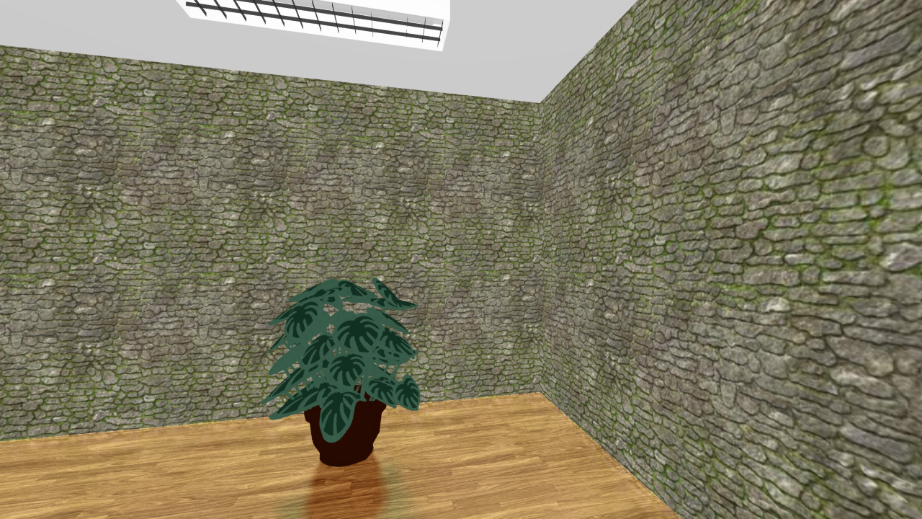
Soft quality – Light & Lighting
Bad lighting

Slide 9
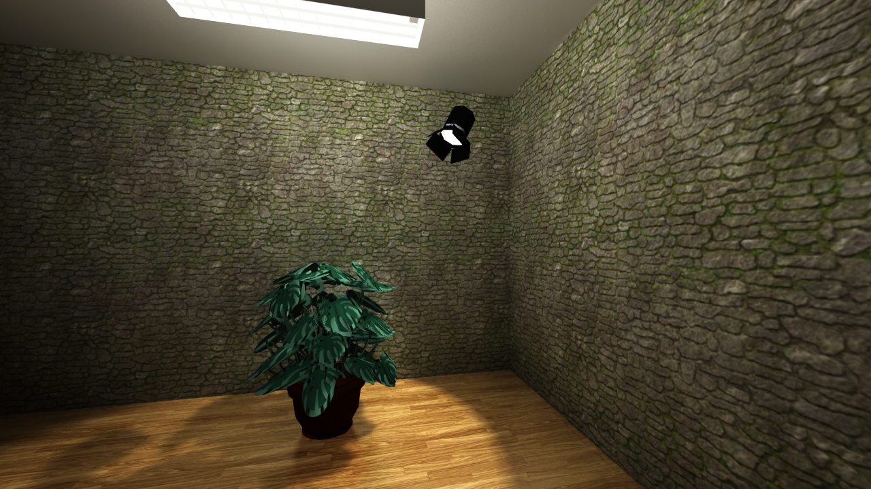
Soft quality – Light & Lighting
Better lighting

Slide 10

Soft quality – Composition
Rule of thirds
Place important picture elements along these lines or at their intersections.
Usually more pleasing.

Slide 11

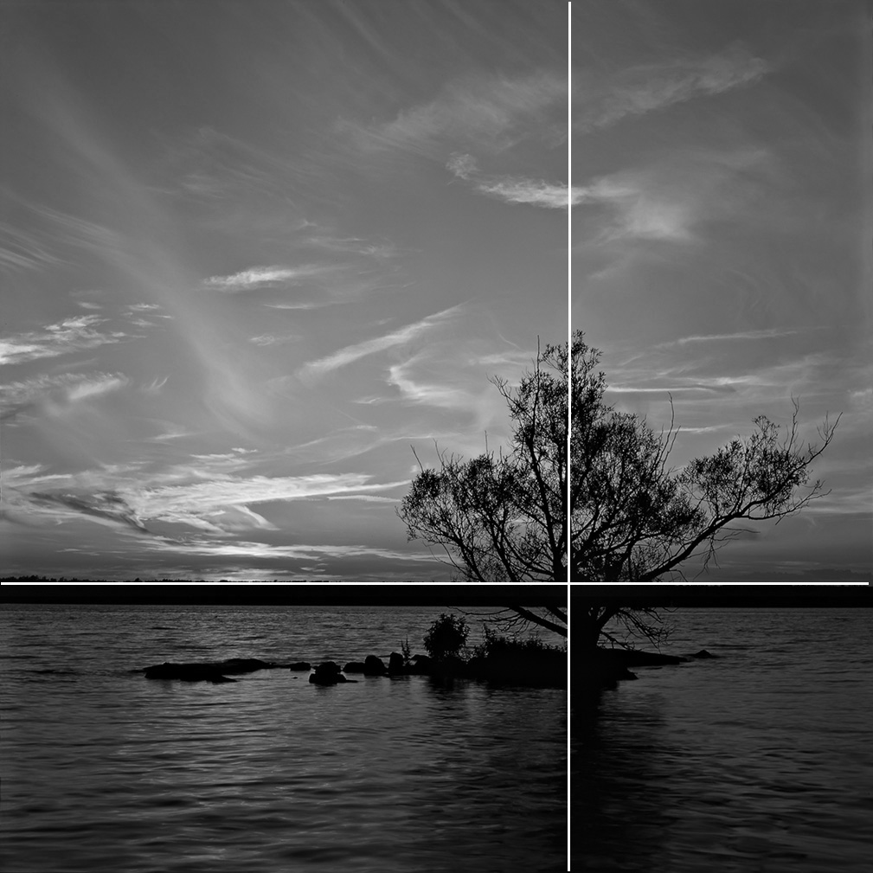
Soft quality – Composition
Rule of thirds

Slide 12
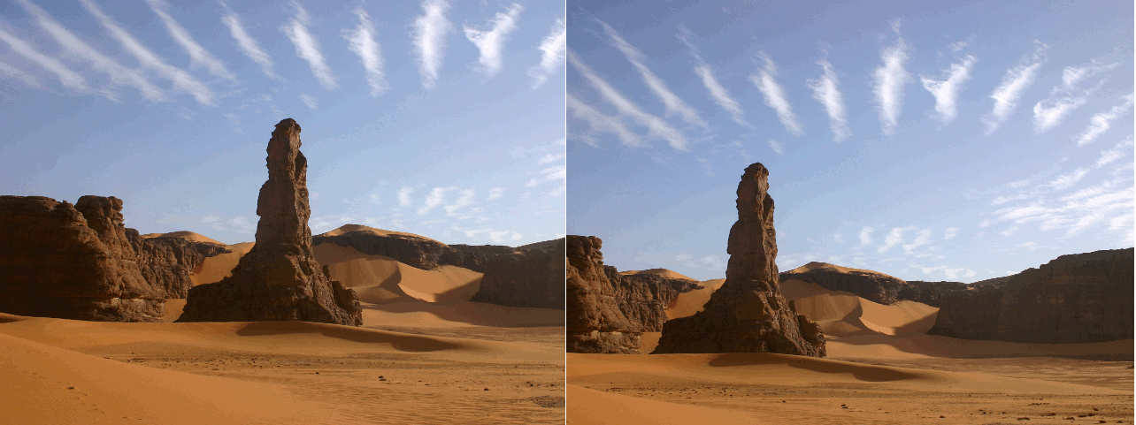
Soft quality – Composition
Rule of thirds
Crop to achieve ”rule of thirds”.

Slide 13
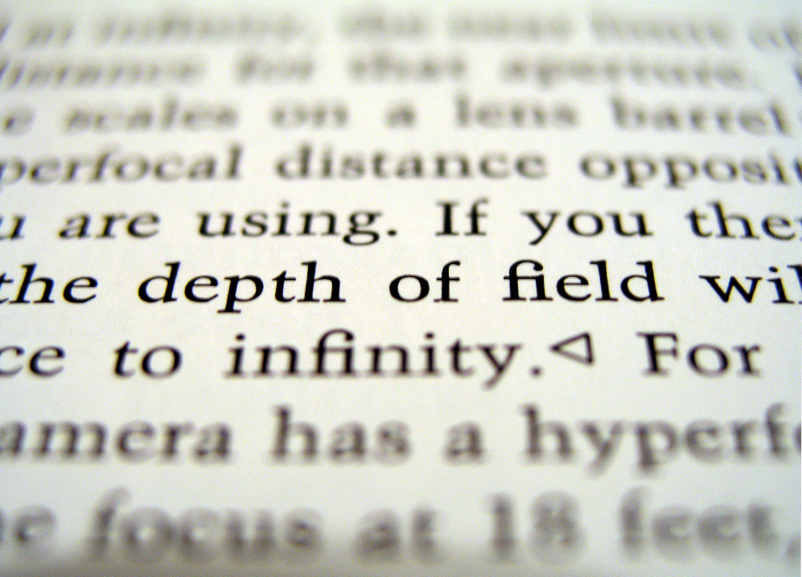
Soft quality – Composition
Depth Of Field (DOF)
Technical (side)effect due to light physics and optical design.
Controlled by aperture and scale.
Can be achieved in renderers.
Can (partly) be ”faked” in post-processing if depth information is availible.

Slide 14


Soft quality – Composition
Depth Of Field (DOF)
Eye in focus
Eye at intersection of first thirds
Use for subject isolation
Draw attention to the subject.
”Calm down” busy backgrounds.

Slide 15

Soft quality – Composition
Depth Of Field (DOF)

Slide 16
Soft quality – Compostion
Compositional rules serves as guidelines only!
Scene dependent.
Rules can be bent or broken.
”Master the rules and you can break them”.

Slide 17
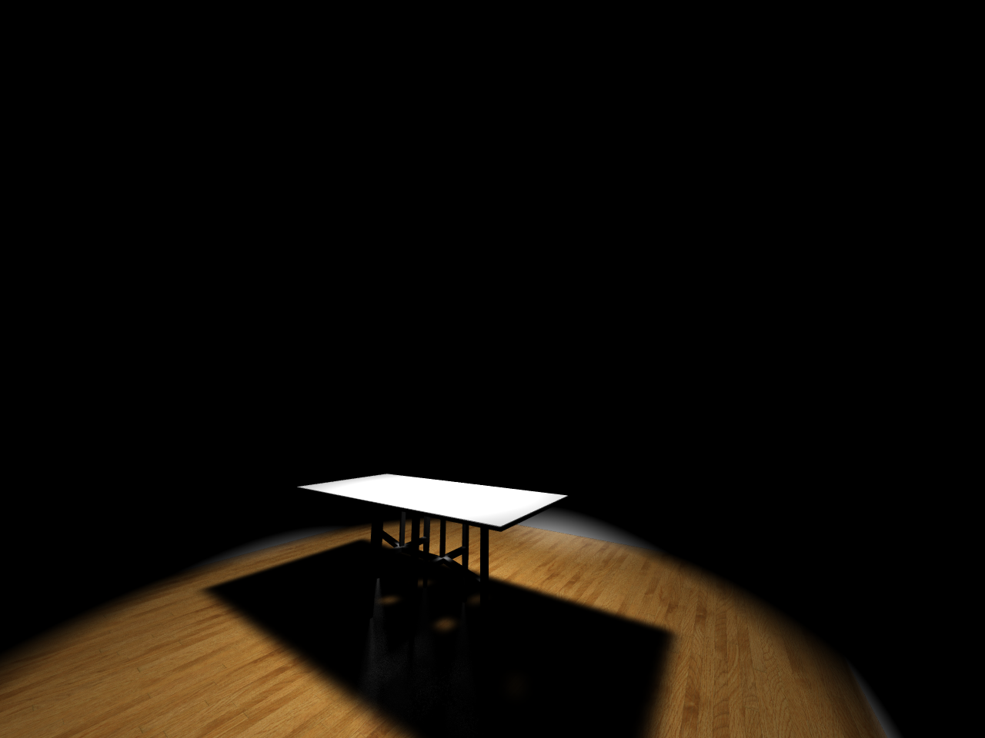
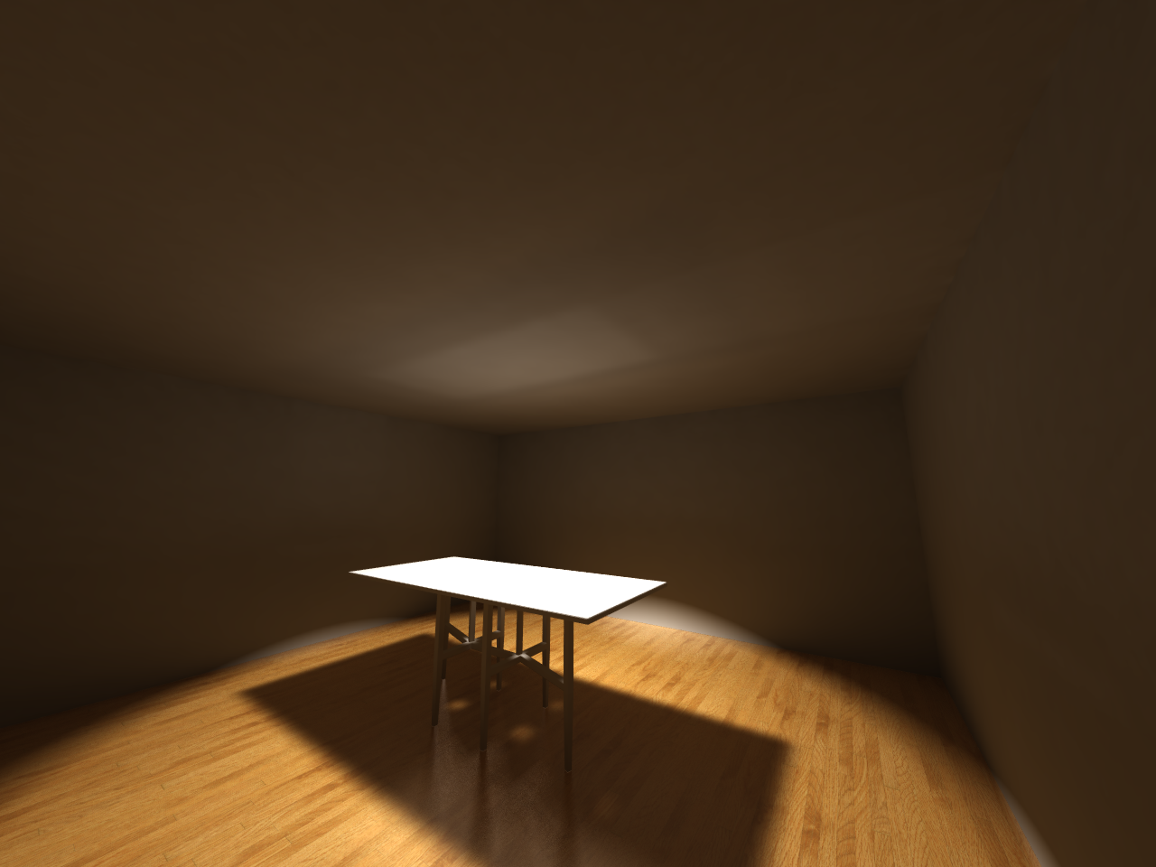
Technical quality – Natural Light rendering
Normal render
Ambient
Natural light, Global Illumination (GI).
Light bounces.
More natural, much more CPU-intensive.

Slide 18
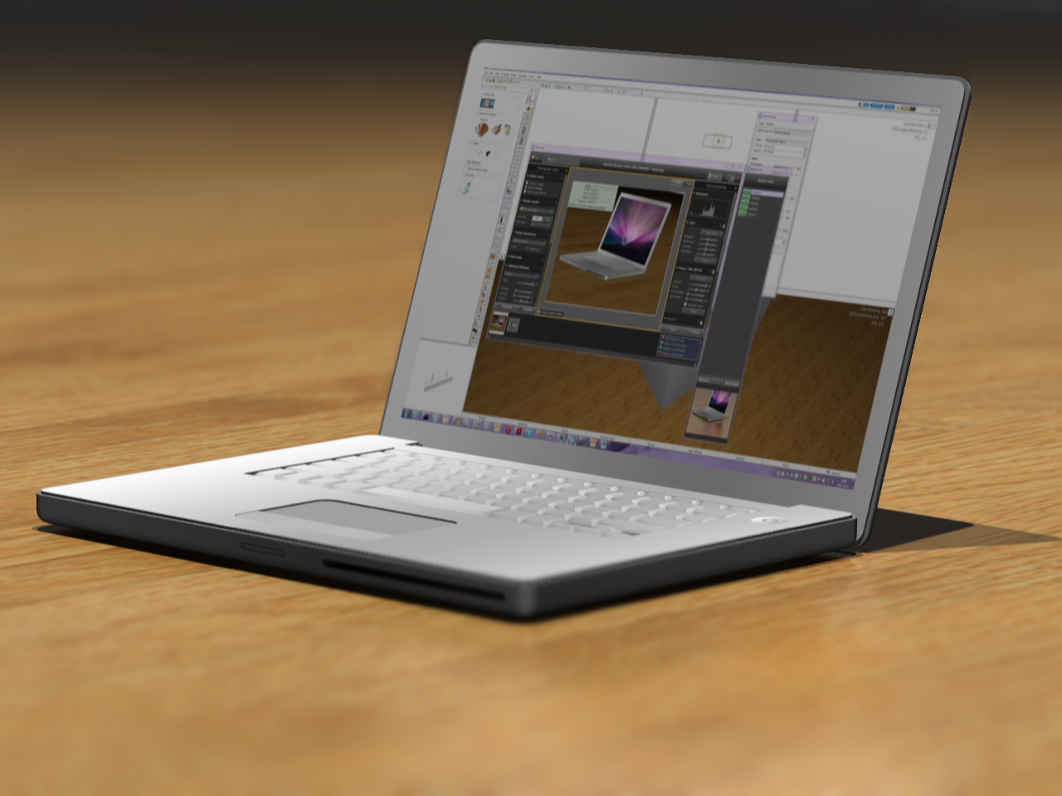



Technical quality – Dynamic range
The range of colors from darkest black to purest white that can be recorded and stored.
Histogram

Slide 19

Technical quality – Dynamic range
The dynamic range of a capture device can be limiting.

Slide 20
Technical quality – Dynamic range
HDR
High Dynamic Range
Represent more tones of colors than ”LDR”.
LDR = 16.7 million colors.
HDR = 79228 trillion trillion colors.
Notes:
HDR cannot be put on paper or shown on screen.
HDR best for post processing!
Computer renderings can be done in HDR.
A digital camera cannot record in HDR, HDR capture can still be done with some tricks.

Slide 21
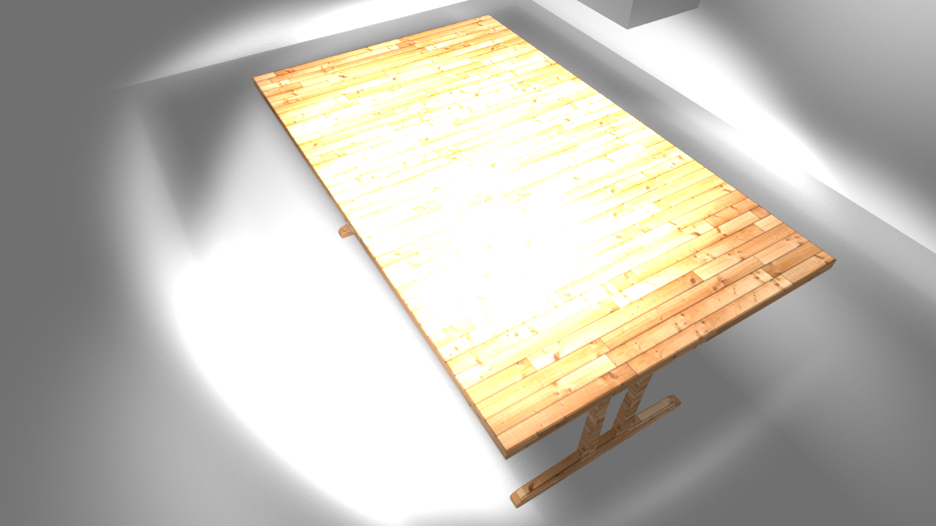
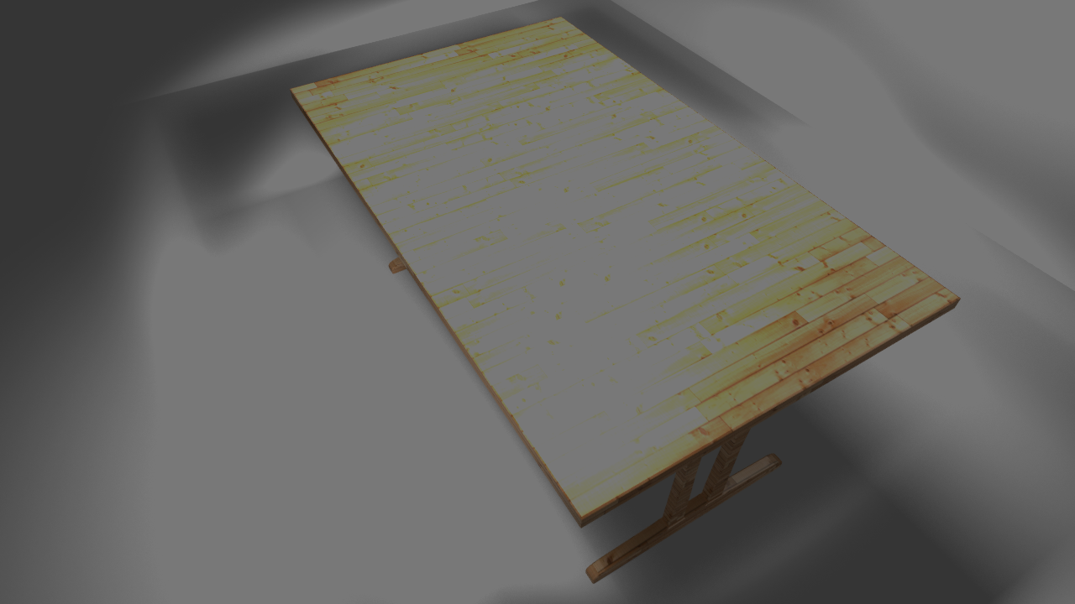
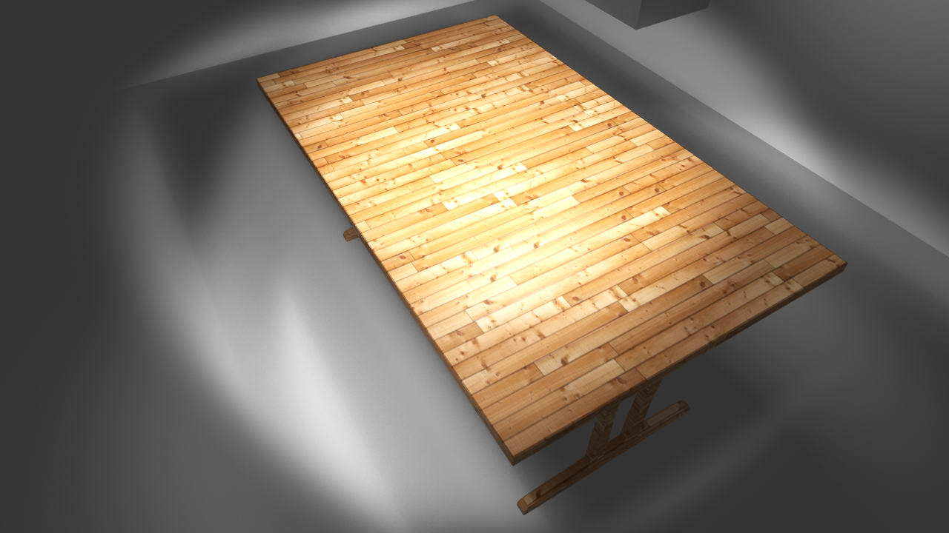
Technical quality – Dynamic range
HDR
Overexposed render
LDR, lowered exposure, details lost
HDR, details can be recovered

Slide 22
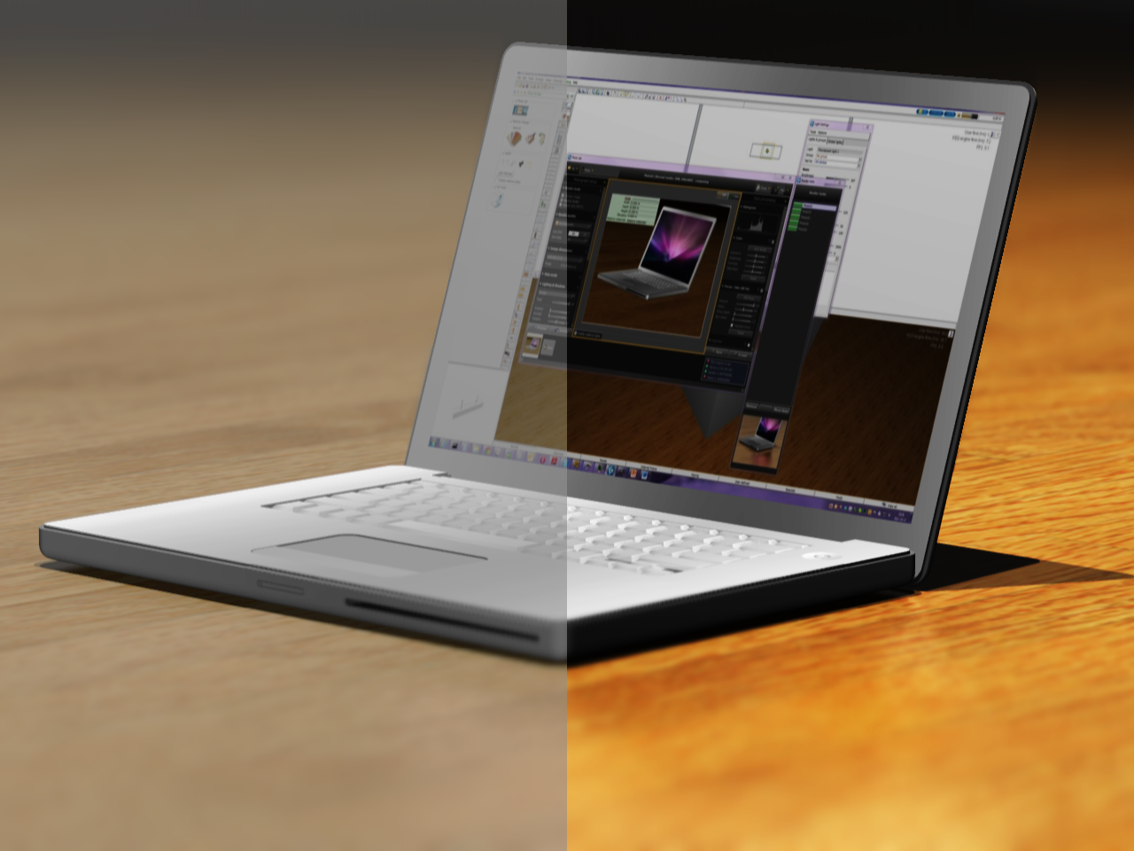


Technical quality – Contrast
Low Contrast
Narrow use of the availible dynamic range
High Contrast
Use all of the availible dynamic range
Notes:
Difference between the brightest and darkest part in an image.
More contrast, More use of the DR.
Increase contrast, Deeper black, brighter highlights.
More contrast, More ”punch”.
Aspire to use the full spectrum.

Slide 23
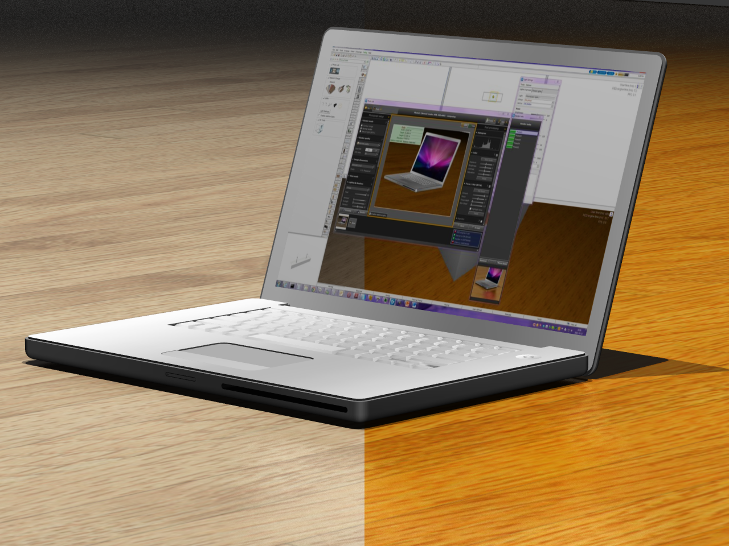
Technical quality – Saturation
Low Saturation
Muted colors, but not totally desaturated.
High Saturation
Vivid colors.
Can easily look exaggerated.
Notes:
Colorfulness, color ”purity” or color contrast.
Fully desaturated = grayscale.

Slide 24
Technical quality – Resolution
What is a pixel?
PixEl, Picture Element.
Smallest building block of a digital picture.
One color only!

Slide 25

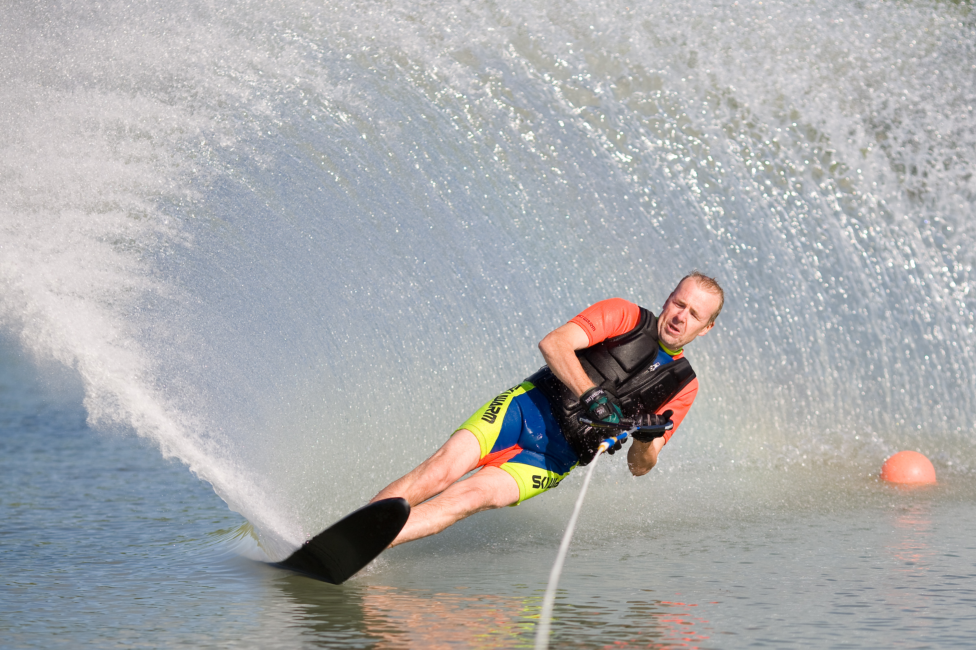


Technical quality – Resolution
What is a pixel?

Slide 26
Technical quality – Resolution
Printing
PPI, Pixels Per Inch
DPI, Dots Per Inch
Great confusion.

Slide 27

Technical quality – Resolution
Printing
How many PPI:s do I need?
The answer: It depends!
Details
Viewing distance & physical size.

Slide 28
Technical quality – Resolution
Printing
How many PPI:s do I need?
Rules of thumb:
Smaller prints, 200 – 300 PPI.
Larger prints, 100 – 200 PPI.
Large poster prints, 50 – 100 PPI.
300 PPI is enough for almost everything!
You never ever need more than 400 PPI!
See for yourselves!

Slide 29
Technical quality – Resolution
Printing
Print an image in letter size with 300 PPI.
What dimensions (pixels) should our render have?
8.5”
2550 pixels
Render at 300 PPI
Digital picture
8.4 MP
Letter
3300 pixels
11”
8.5 x 300 = 2550
11 x 300 = 3300

Slide 30
Technical quality – Resolution
Printing
I have an image file that is 1920 x 1080 pixels.
What is the largest physical print I can create at 200 PPI?
1920 pixels
9.6”
1080 pixels
Digital image
5.4”
Physical print
1920 / 200 = 9.6
1080 / 200 = 5.4

Slide 31
Thanks for your attention!
Questions?

